Slide 1
Dr. Emily Christina Murphy
Assistant Professor, Digital Humanities
University of British Columbia, Okanagan
PI, ReMedia Infrastructure
Visiting Scholar, Critical Digital Humanities Initiative, University of Toronto
ecbmurphy.ca
Project-Focused
Contract Grading
Slide Design: Kai Hagen ReMedia Design Consultant, Bachelor of Media Studies

Slide 2
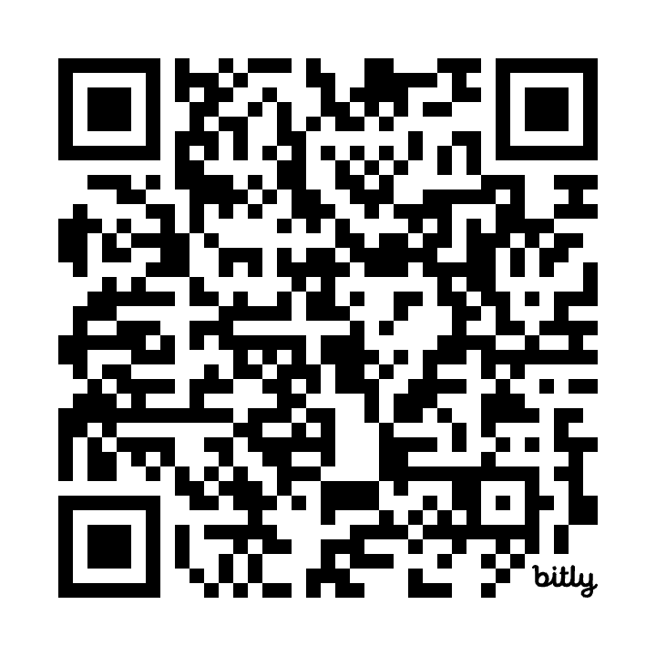
LINK: https://bit.ly/CTL_ContractGrading

Slide 3
Contract Grading: an evaluation approach that stages a negotiation between instructor and students mediated through a ‘contract’ in which students choose which grade they will work towards within a range of options presented to them

Slide 4
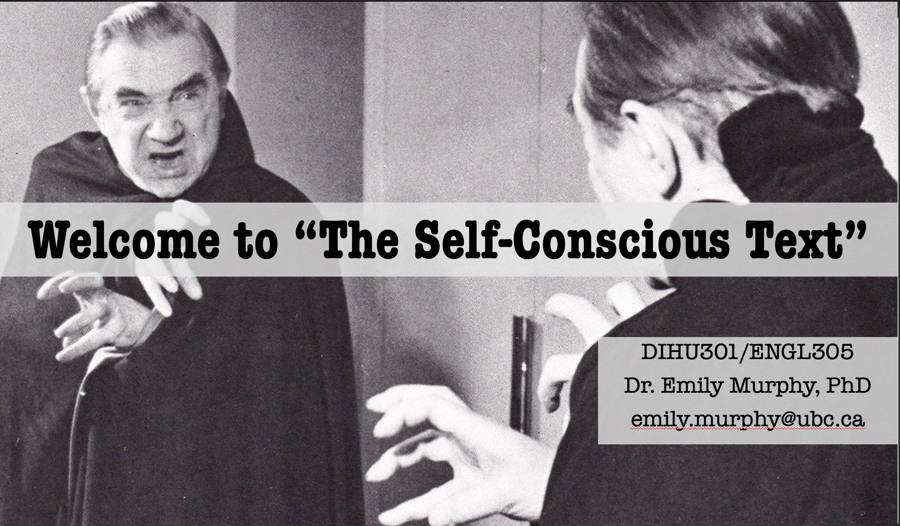

Slide 5
Addresses computational methods for student-led humanities research, including visualizing, mapping, and encoding. No digital humanities or computing experience required.

Slide 6
Contract Grading: an evaluation approach that stages a negotiation between instructor and students mediated through a ‘contract’ in which students choose which grade they will work towards within a range of options presented to them

Slide 7
Assumptions:
Students complete all work to a passable level, and revise if assignments are not passable
Usually higher grades entail more labour or volume on the part of students
A grade has neutral value OR
Grades interfere with learning

Slide 8
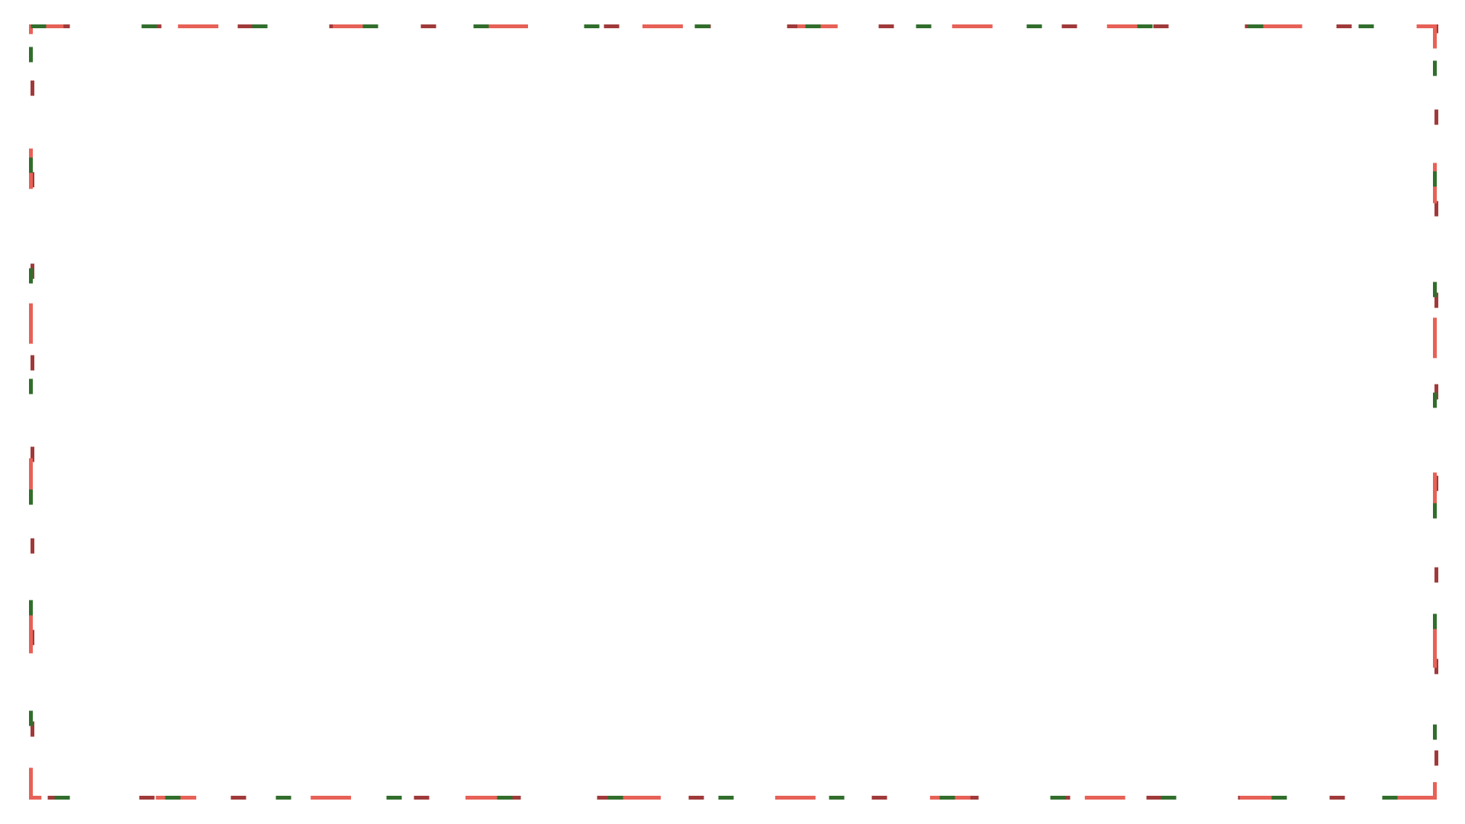
The advantage of contract grading is that you, the student, decide how much work you wish to do this semester; if you complete that work on time and satisfactorily, you will receive the grade for which you contracted. This means planning ahead, thinking about all of your obligations and responsibilities this semester and also determining what grade you want or need in this course.… I respect the student who only needs a C, who has other obligations that preclude doing all of the requirements to earn an A in the course, and who contracts for the C and carries out the contract perfectly. (This is another one of those major life skills: taking responsibility for your own workflow.) - Cathy Davidson

Slide 9
Ryan Cordell’s Text Technologies class: To contract for an “A” in this course, you agree to: - Earn “Satisfactory” on all class preparation assignments save two. - Miss no more than two classes. - Take no more than one information overload day during the semester. - Exceed expectations regarding in-class device according to the policies outlined in the device use rubric. - Write at least nine “Satisfactory” lab reports over the course of the semester. As specified in the assignment, lab reports are due within one week of the pertinent laboratory activity. - Complete two “Satisfactory” Unessays on a schedule you will specify in your contract and present the strongest in class on December 4. https://f19tot.ryancordell.org/assignments/

Slide 10
“Aggregate Model”

Slide 11
Variations and related approaches
Labour only (Asao B. Inoue)
“Specifications grading” (Linda Nilson): Students can make choices that support their production of rigorous work; contract negotiated weights for different assignment “bundles”
Preserved evaluation (J. Danielewicz and P. Elbow, and many others): All students start with a B (for example) if they complete the assignments, and may improve that grade based on the quality of the work
Ungrading: Grades interfere with learning and grades-based assessments should be radically divorced from student learning (Susan D. Blum, Alfie Kohn, and Jessie Stommel)

Slide 12
Contexts:
Technical writing;
Elementary, secondary, and postsecondary writing instruction;
Digital humanities pedagogy
Computer Science, Statistics, and UX/digital design courses
Social Work
Psychology and other experimental science fields

Slide 13
This model didn’t work for me (at first)

Slide 14
In the class’s large, core assignment, students produce a mini edition of a single chapter from a novel, fleshing out the TEI markup of the chapter to include editorial apparatus like footnotes and contextual information, and including a prose introduction to situate the edition. Students create a research question, pursue that research through an annotated bibliography, and iteratively refine the question into a focused editorial intervention supported by markup.

Slide 15
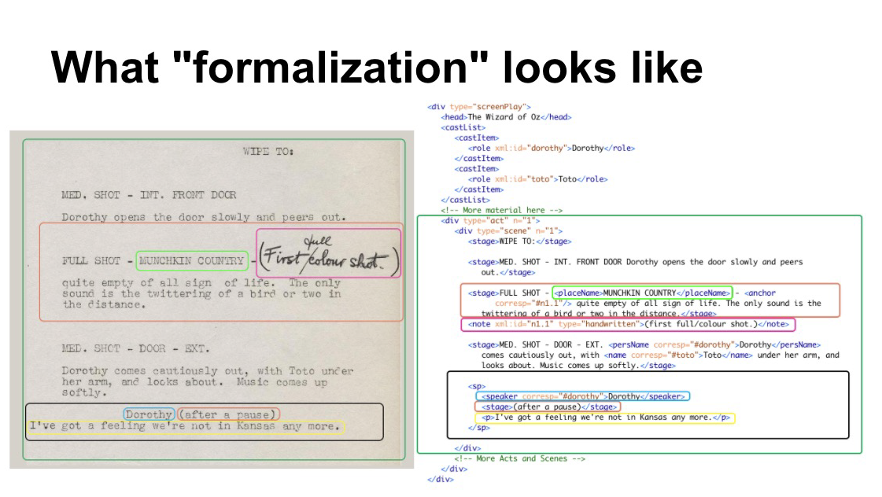
TEI-conformant XML: a markup language used in scholarly editing that emphasises formal description of a text and de-emphasises formatting

Slide 16
Pragmatic Problem:
Media specificity of the editions, including digital editions, means it can’t be partitioned easily.

Slide 17
Intellectual problem:
Scope is not simply size or volume. It is also complexity.

Slide 18
Why keep the edition?
Explicit focus on audience
Development of critical technical skill
Development of humanities skill in textual analysis and interpretation
Development of skills in iteration and conceptual consistency across a complex project
Comprehension of how cultural heritage is constructed by authors, editors, and publishers

Slide 19
Challenge: How can I preserve the complexity and integrated development of skill of the digital edition while also using contract grading to find a (small) structural solution to the pressures I knew were interfering with student learning?

Slide 20
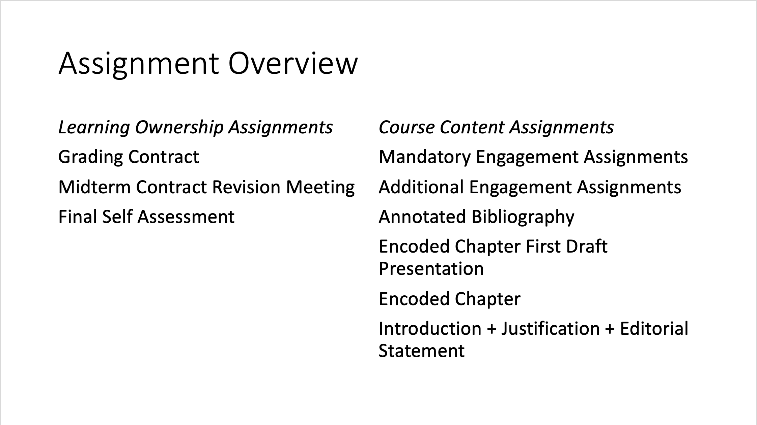

Slide 22
Assignment descriptions:

Slide 23
Benefits: - Made previous improvements to the course much more legible; - Students produced exemplary work; - Reduced my grading time (or at least felt like it did); - Challenged me to think carefully and clearly about concepts like scope, which are especially important in project-based and non-written work; - Made me a much more intellectually generous instructor.

Slide 24
Limitations/Things that need work: - I chose to retain an aspect of evaluation; - About the same number of students failed the course, but the course median was higher; - Easy for students to move down a grade, but not to move up a grade; - Labour still conforms to structures of inequality.

Slide 26
Options:
Discussion
Prompts for contract grading worksheet

Slide 27





THANK YOU

